Slide 1



Getting Started with Azure Data Studio
Eduardo Pivaral (MCSE, MCSA) – Sep 2020

Slide 2




Sponsors

Slide 3




Slide 4





Eduardo Pivaral
Experience
+15 Years of experience working on IT
+10 Years of experience working with SQL Server
Developer of Open Source tools for SQL Server administration, development and productivity.
Certifications
SQL Server Database Consultant @ Pythian
Azure Database Administrator Associate
Azure Fundamentals
MCSE Data Management and Analytics
MCSA SQL 2016 Database Development
MCSA SQL 2016 Database Administration
MCSA SQL 2012/2014
www.sqlguatemala.com
Eduardo Pivaral
Community
@EduardoDBA
Regular Author for MSSQLTips.com
Regular Author for SQLServerCentral.com
MSSQLTips.com Rookie of the year 2018
Board member of Guatemala SQL Server User Group
Owner of SQLGuatemala.com
Epivaral

Slide 5

AGENDA
What is it? (in 200 seconds or less)
What does it offer?
Basic usage and options
A lot of Demos!

Slide 6

What is it?

Slide 7

Formerly known as SQL Operations Studio
Based on VSCode
General Availability version released on September 2018
Tool for data professionals using Microsoft Products
Cross-Platform, Can be used on Windows, MacOS and Linux
Open Source! Code available at: https://github.com/microsoft/azuredatastudio
Get it now at
https://aka.ms/azuredatastudio

Slide 8
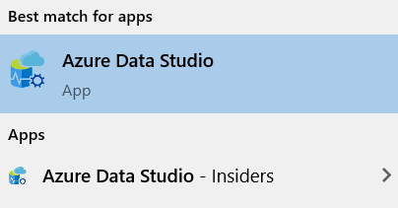
There are 2 versions
Normal Build:
Latest stable release
Build available when you access the download page
Use it on your daily job duties
Insiders build:
A “beta” version
Released more often (almost daily)
Contains latest features and fixes
Use it just for testing new features
Available at: https://github.com/microsoft/azuredatastudio#try-out-the-latest-insiders-build-from-main
You can install both versions independently

Slide 9

It is not meant to replace SSMS, why?
Use Azure Data Studio if you:
Need to run on macOS or Linux
Are connecting to a SQL Server 2019 big data cluster
Spend most of your time editing or executing queries
Need the ability to quickly chart and visualize results
Can execute administrative tasks via terminal using sqlcmd or Powershell
Can do most administrative configurations via T-SQL
Use SQL Server Management Studio if you:
Spend most of your time on database administration tasks
Are doing deep administrative configuration
Are doing security management
Make use of the Reports for SQL Server Query Store
Need to make use of performance tuning advisors and dashboards
Need access to Registered Servers and SQL Server services on Windows

Slide 10
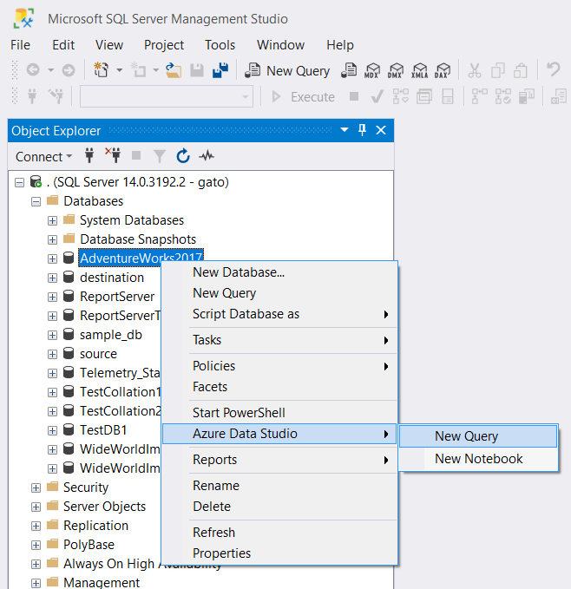
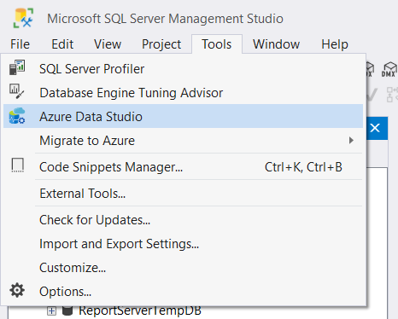
Or you can simply use both…
You can open ADS from SSMS (starting on SSMS 18.0)

Slide 11

What does it offer?

Slide 12

Key Features
Lightweight (it usually loads faster than SSMS)
Modern code editor with IntelliSense
Smart code completion and snippets
Object Explorer
Server groups
Dashboards
Edit Data
Code navigation
Export results to CSV, XML, JSON, Excel
Chart results
Extensibility and customization
Notebooks
Integrated terminal
Source Control
Monthly Updates and bug fixes

Slide 13
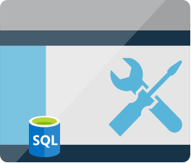
Basic Usage and Options

Slide 14
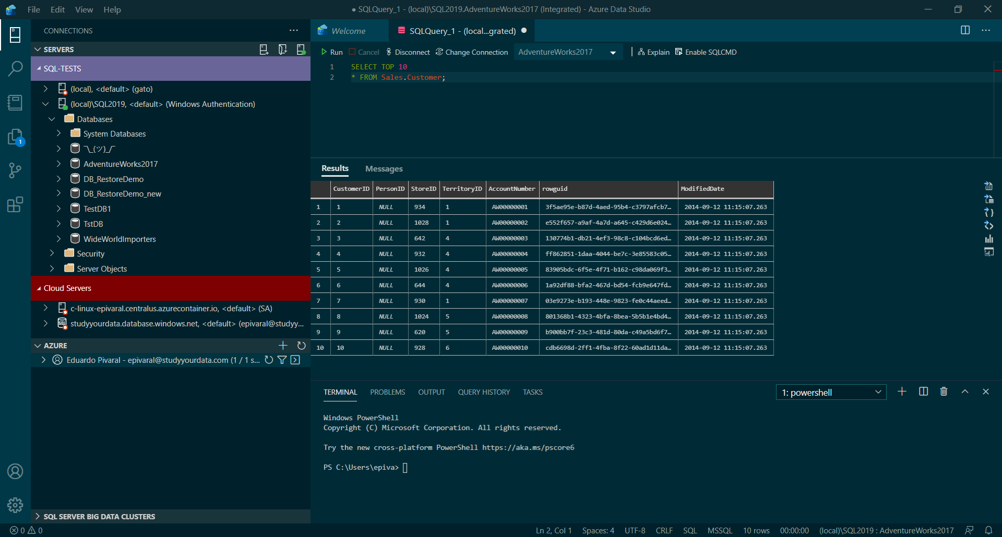
1. Main Menu
3. Editor (Query, Notebook, files, options)
2. Sidebars
Connections
Find
Explorer
Source Control
Extensions
4. Results
5. Terminal

Slide 15
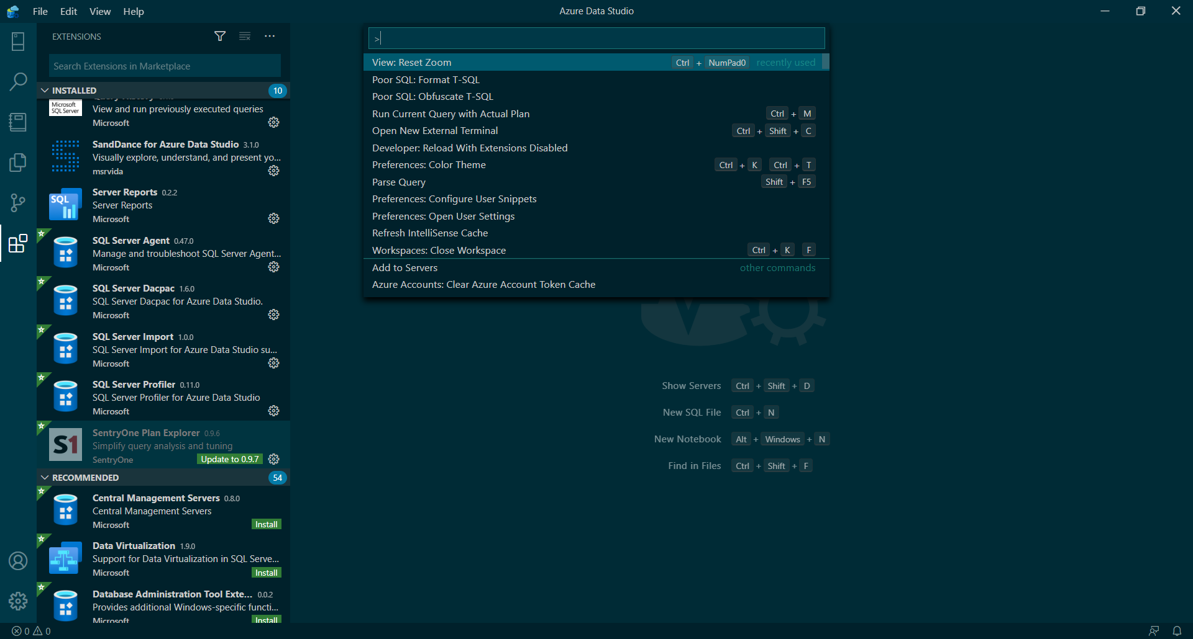
1. Command Palette
2. Status bar
3. Settings

Slide 16
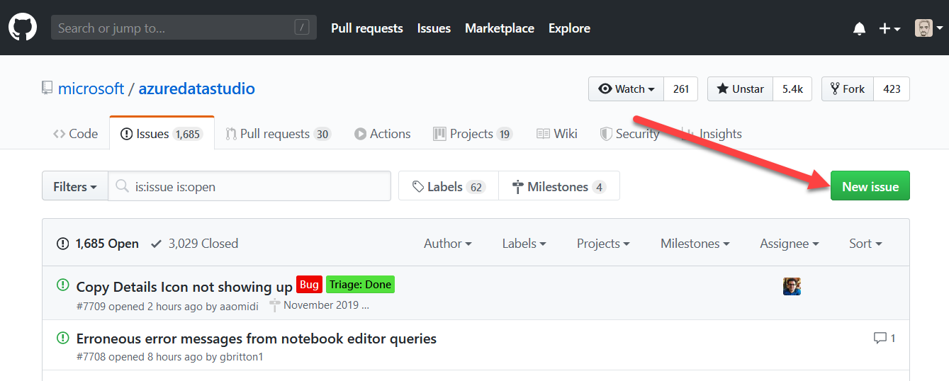
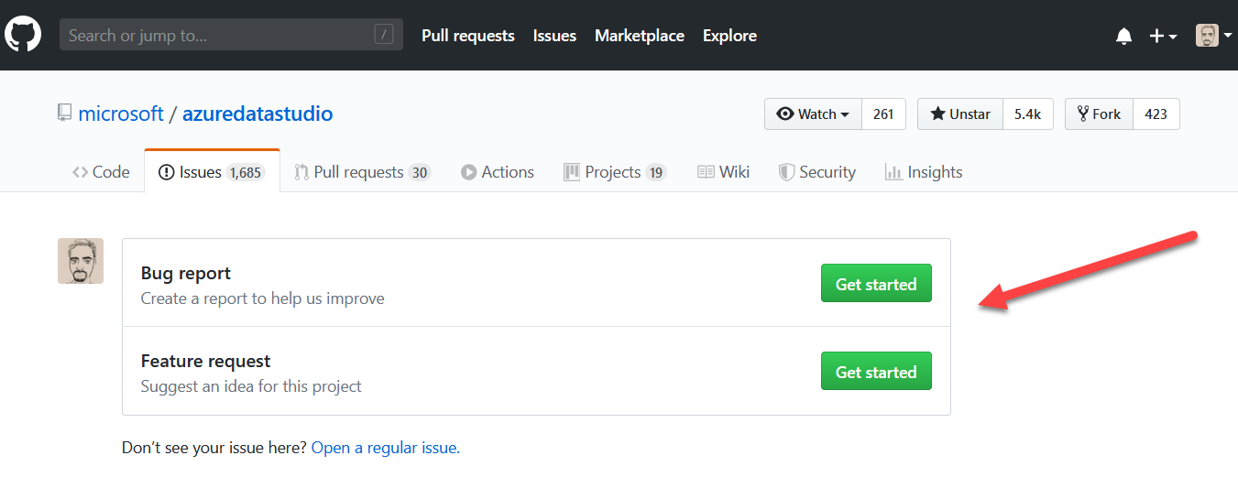
Submitting issues

Slide 17
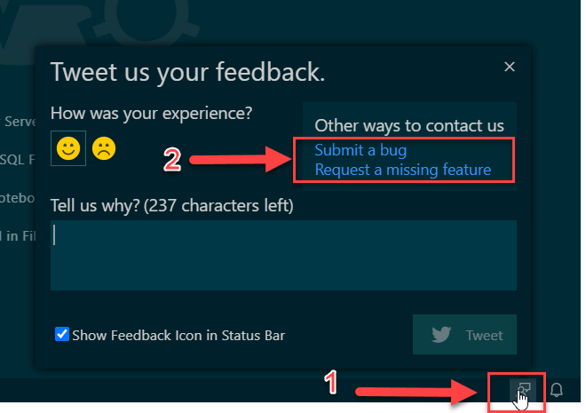
Submitting issues
Direct from the tool…

Slide 18

DEMOS

Slide 19

Thank you!
Want to know more? Having doubts about this presentation?
Visit me at:
www.SQLGuatemala.com
Eduardo Pivaral
@EduardoDBA
Epivaral
Material available at
https://github.com/Epivaral/Sessions

